Slide 1
Flood Situation in the project area(Damage)
Design of different type of protection work.
Activity plan for civil works next two dry seasons
Status of agriculture component and plan for next FY
Discussion on civil works monitoring format

Slide 2
Physical Achievement up to 30thOctober, 2020
Sl No. | Item of Physical Work as per 1st RDPP |  |  |  |  | Progress up to 30th October, 2020 | Progress (%)
 | Name | Quantity | No of Package | Cost in Crore Taka | On going Packages
1 | 2 | 3 | 5 | 4 | 6 | 7 | 8
New Haor: (14 Nos.) |  |  | 52 Nos |  | Kishoregonj 27 Nos. Habigonj 6 Nos. Netrokona 8 Nos. Sunamgonj 6 Nos. Total 47 Nos. Contract Price of 47 Nos. Packages = 472.37 Crore
1 | Construction of Submersible Embankment | 263.24 km |  | 119.53 |  | 156 km (Full) +54 km (Part)= 210 km | 72.57%
2 | Re-excavation of Khal/River | 318.20 km |  | 97.29 |  | 187 km (Full) +73.00 km (Part) = 260 km | 72.53%
3 | Construction of Regulator/ Causeway/Drainage Box Outlet | 137nos (57+35+1+44) |  | 203.11 |  | 50 nos. (Full) +30 nos. (Part) = 80 Nos. | 49.64%
4 | Construction of Irrigation Inlet | 131 nos. |  | 12.61 |  | 43 nos. (Full) +17 Nos. (Part) = 60 Nos. | 40.61%
5 | Rehabilitation of Regulator | 8 nos. |  | 1.66 |  | 1 No (Full) = 1 No. | 12.50%
Rehabilitation Haor: (15 Nos.)
1 | Construction of Submersible Embankment | 87.03 km |  | 17.85 |  | 51 km (Full) +4 Km (Part) = 55 km. | 61.36%
2 | Construction of Full Embankment | 84.31 km |  | 25.50 |  | 53 km (Full) +12 km (Part) = 65 km | 71.40 %
3 | Re-excavation of Khal/River | 143.00 km |  | 25.15 |  | 65 km (Full) +15.00 km (Part)= 80 km | 51.75%
4 | Re-installation/Construction of regulator/ Causeway | 7 nos. |  | 15.15 |  | 1 No. (Full) = 1 No. | 14.29%
5 | Replacement of Gate | 104 nos. |  | 3.63 |  | 43 nos. (Full) = 43 Nos. | 41.35%
6 | Construction of WMG Office | 60 Nos. |  | 13.80 |  | 4 nos. (Full) +4 Nos. (Part) = 8 Nos. | 10.67%
 | Total |  | 52 Nos. | 535.27
Physical Progress = 63 %

Slide 3
Progress of Irrigation Inlet

Slide 4
Progress of Reinstallation of Regulator (Rehab-Haor)

Slide 5
Progress of Construction of Regulator/Causeway/Box Drainage Outlet

Slide 6
Progress of Re-excavation of Khal/River (New Haor)

Slide 7
Progress of Re-excavation of Khal/River (Rehab Haor)

Slide 8
Progress of Repair of Full Embankment (Rehab Haor)

Slide 9
Progress of Rehab of Submersible Embankment (Rehab Haor)

Slide 10
Progress of Construction of Submersible Embankment (New Haor)

Slide 11
Progress of Rehabilitation of Regulator(New Haor)

Slide 12
Progress of Construction of WMG Office

Slide 13
Progress of Construction of Threshing Floor

Slide 14
Progress of Replacement of Regulator Gates

Slide 15
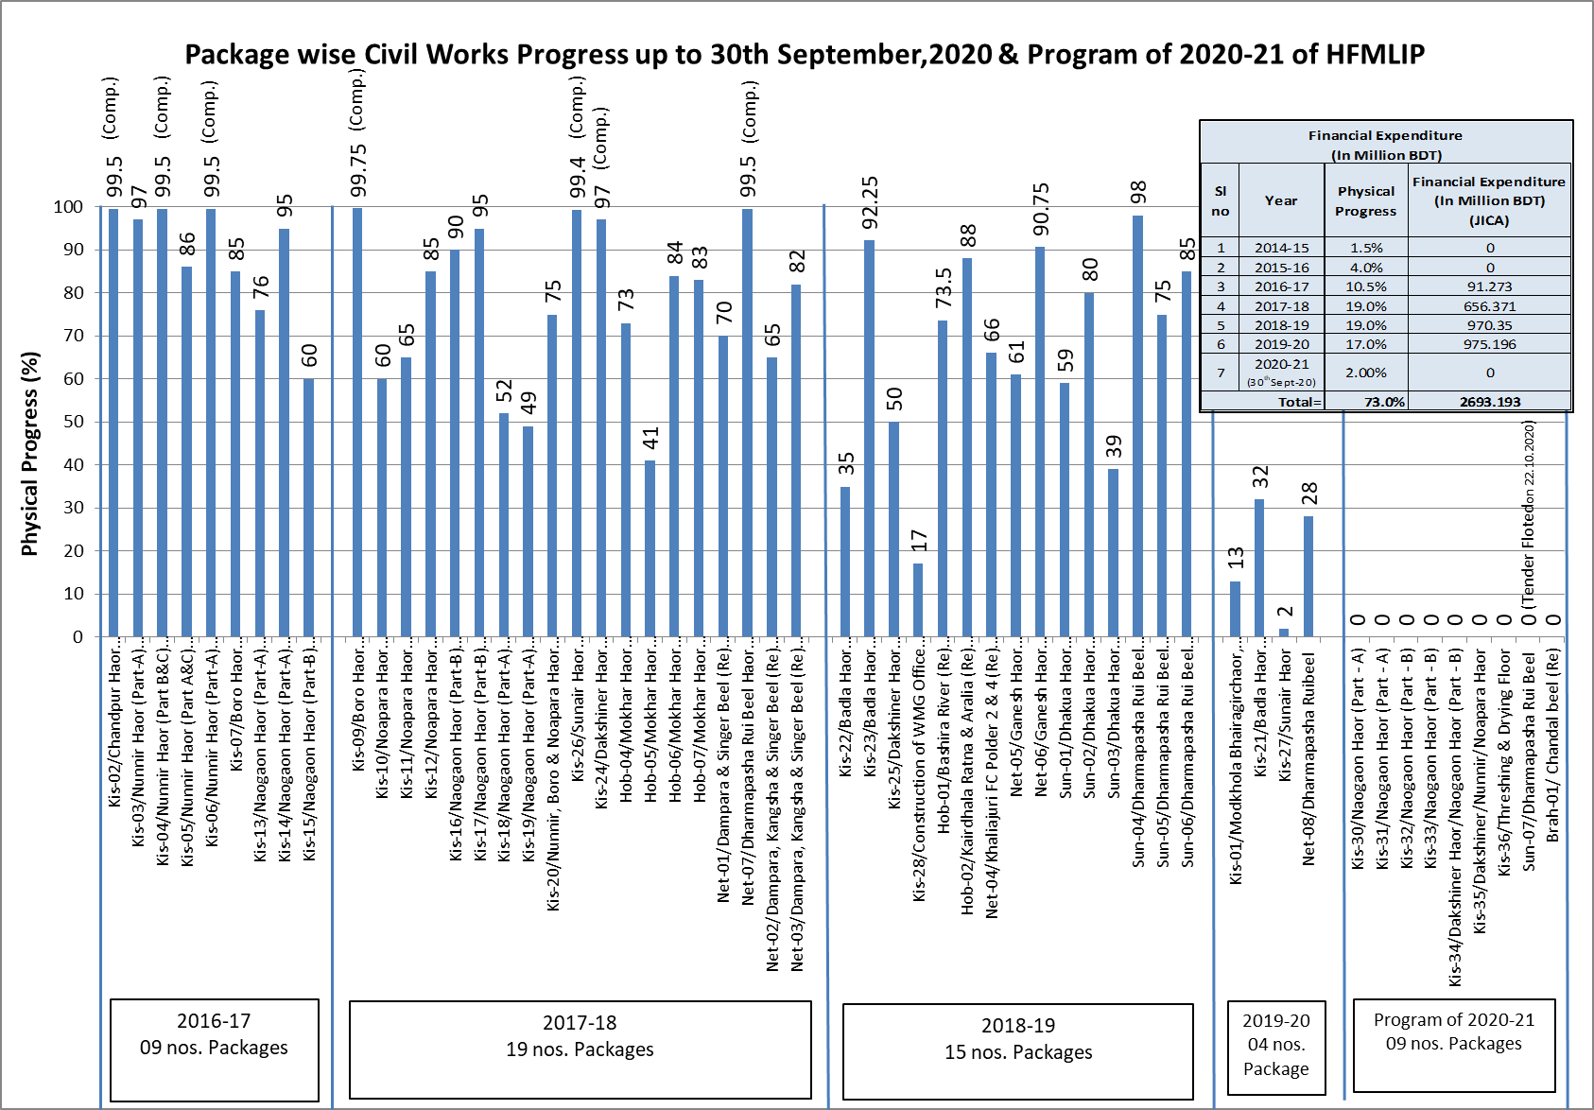

Slide 16
Financial Status of JICA Money
SL | Description | Amount
1. | Total Fund for Livelihood & Physical work | = 515.44 Crore
2. | Total expenditure up to Sept. 2020 | = 294.18 Crore
 | Remaining Fund | = 221.26 Crore
Fund requirement
1. | October to December, 2020 | = 4.20 Crore
2. | January to March, 2021 | = 41.70 Crore
3. | April to June, 2021 | = 85.00 Crore
 | Total | = 130.90 Crore
Fund requirement
 | July, 2021 to June, 2022 | = 90.30 Crore

Slide 17
Sl. No. | Tender Status as per 2nd RDPP | Remarks
1 | 55 Nos of Packages As Per 2nd RDPP 47 Packages already Tender and work is on going.8 Nos Packages is Completed Upto October,2020.
2 | Remaining 9 Packages are to be tendered the F/Y (2020-21) ,already for 8 nos package tender is floated. 1 no Package for Gate Replacement at Satdona & Chahal Beel Sub-Project in Brahmanbaria District.
Financial Year | Tender Invitation (No) | Package Completion (No) | Target for completion (TFC)
2016-17 | 9 | 3
2017-18 | 19 | 4
2018-19 | 15 | 1
2019-20 | 4
2020-21 | 8 |  | 30 Nos.
Total | 55 | 8

Slide 18
Cumulative Progress of Project (upto 30-09-2020) : Financial = 59381.08 Lakh (61.09%)
Project Progress = 73%
Reasons for difference of progress (Financial & Physical).
RDPP Item & Task with cost | Expenditure incurred (%) | Physical (%)
Consultancy: Total amount : Tk. 7901.40 Planning Review Sub Soil Investigation Design Estimate Monitoring & Supervision RAP Implementation Environmental Study | 5618.01 (71.10%) | 80%
Physical Work : Total amount : Tk. 53727.00 Detailed Estimate Tender Float Notification of Award (NOA) Work Order (W/O) Mobilization Work done | 30875.04 (57.47%) | 68%
RDPP Item & Task with cost | Expenditure incurred (%) | Physical (%)
Land Acquisition 240 ha Tk. 24000.00 (Lakh) | 15323.60 (63.85%) | 65%
Tax and VAT : Total amount : Tk. 2596.27 | 1809.73 (69.70%) | 69%
Procurement of Goods & Vehicles : Total amount : Tk. 1066.22 | 856.62 (80.34%) | 80%
Office Administration: Total amount : Tk. 3660.54 Salary of Out Sourcing staff Office Rent Gas & Petrol Repair Maintenance Others | 2228.44 (60.88%) | 60%
Total : Tk. 97204.86 | 59381.08 (61.09%) | 73%
Contingency : Total amount : Tk. 660.14 | 0 | 0
Grand Total amount : Tk. 97865.00 | - | -
Livelihood Improvement by Agriculture Promotion: Total amount : Tk. 4253.43 Local Training APSS SIGS | 2669.63 (62.76%) | 69%

Slide 21
Financial Expenditure (In Million BDT)
Sl no | Financial Year | Physical Progress | GOB | Project Aid (PA) |  |  |  | Total | Cumulative expenditure (in Million BDT)
 |  |  |  | RPA |  | Total RPA | DPA For Consultant
 |  |  |  | Civil Works | Livelihood
1 | 2 | 3 | 4 | 5 | 6 | 7 | 8 | 4+5+6+7
1 | 2014-15 | 1.5% | 60.662 | 0.0000 | 0.00 | 0.00 | 84.96 | 145.6 | 145.6
2 | 2015-16 | 4.0% | 82.428 | 0.0000 | 0.92 | 0.92 | 184.94 | 268.3 | 413.9
3 | 2016-17 | 10.5% | 555.849 | 91.2730 | 34.91 | 126.18 | 109.32 | 791.3 | 1205.3
4 | 2017-18 | 19.0% | 782.197 | 656.3710 | 78.98 | 735.35 | 68.93 | 1586.5 | 2791.7
5 | 2018-19 | 17.0% | 631.334 | 970.3530 | 93.99 | 1064.35 | 68.64 | 1764.3 | 4556.1
6 | 2019-20 | 15.0% | 312.082 | 975.1960 | 39.82 | 1015.01 | 45.00 | 1372.1 | 5928.2
7 | 2020-21 (30thSept-20) | 1.0% | 9.948 | 0.0000 | 0.00 | 0.00 | 0.00 | 9.948 | 5938.1
Total |  | 68.0% | 2434.5 | 2693.2 | 248.6 | 2941.8 | 561.8 | 5938.1

Slide 22
Flood Situation in the project area(Damage)
Design of different type of protection work.
Activity plan for civil works next two dry seasons
Status of agriculture component and plan for next FY
Discussion on civil works monitoring format

